Slide 1





HackOrbit 2025
MediMinds

Slide 2

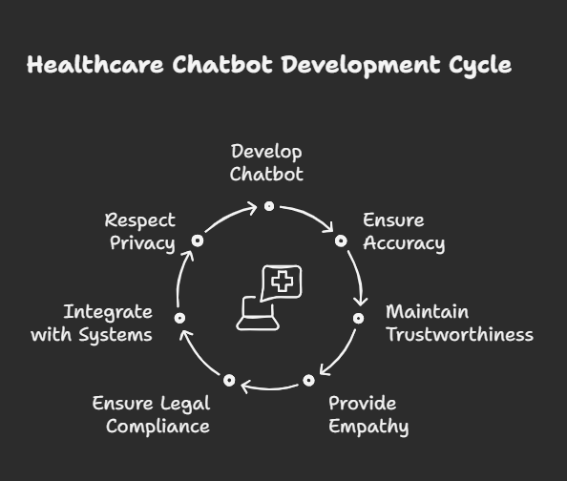
Theme:- Healthcare Teachnology
Problem Statement Title:- AI-Powered Healthcare Chatbot Platform
• Building a Healthcare Chatbot Website that delivers accurate, trustworthy, empathetic, and legally immediate preliminary medical support—while seamlessly integrating into healthcare systems and respecting user privacy.

Slide 3
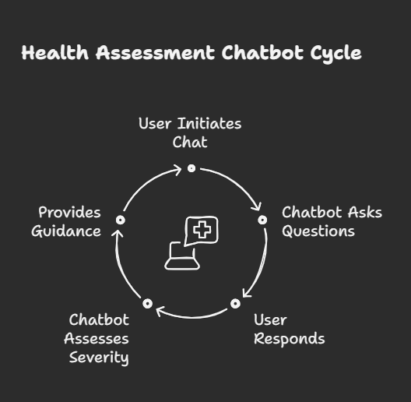
PROPOSED SOLUTION:
• Web-Based Chat Interface:
Clean, mobile-friendly UI with prompts like “Describe Symptoms” or “Get Advice.
• Simple Rule-Based Flow:
Chatbot asks key questions (e.g., “Do you have chest pain?”)
Response guides them based on severity:
Mild → Self-care tips
Moderate → See a doctor
Serious → Urge emergency action
• Safety & Clarity :
Bold disclaimer: “Not professional medical advice”

Slide 4
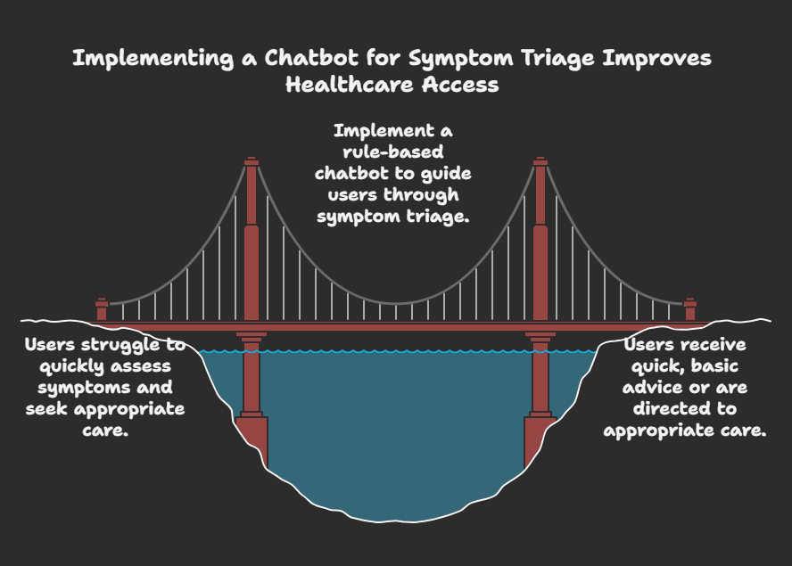

Slide 5
To define the structure and content of a webpage.To define the structure and content of a webpage.
IDEAS / APPROACH:
TECHNICAL APPROACH
FRONTEND:
• HTML : To define the structure and content of a webpage.
• CSS : For styling of webpage.
• JAVASCRIPT : To add interactivity and dynamic features to web pages.
BACKEND :
• Server:--AWS Cloud server
• Database:-- MYSQL
• Backend Programming Languages:--node.js
• Content Management System (CMS):--WordPress
• Authentication and User Management:--OAuth

Slide 6
FEATURES AND NOVELTY:
Continuous availability: Assistance is always available online basis for 24/7
Reduced workload: Automates routine tasks, freeing up medical staff.
Better patient engagement: Personalized education, 60–64% of users prefer chatbots for inquiries
Cost savings: AI chatbots could save healthcare systems billions
Symptom triage: Ask questions, guide urgency.

Slide 7
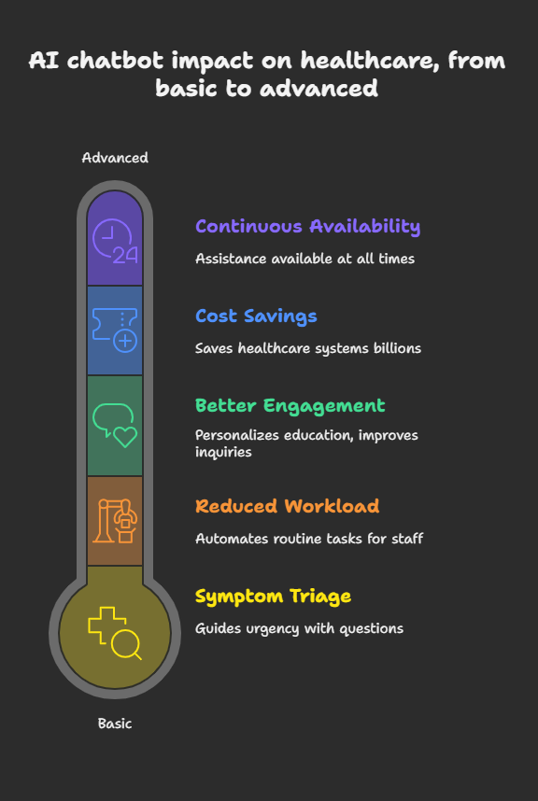

Slide 8
⚠DRAWBACK
• Limited diagnostic accuracy
• Lack of empathy and emotional nuance
• Data privacy & security concerns
• Over-reliance and misuse
• Ethical and legal risks
🛑 SHOWSTOPPERS:
• Misdiagnosis leading to harm
• User distrust or abandonmen
• Privacy breaches
• No regulatory recognition

Slide 9
MEDIMINDS:
‘• AKANSHA SINGH TOMAR
CONTACT NO : 7879222572
• KIRAN TOMAR
CONTACT NO: 6266788661

Slide 10
THANK YOU

